Slide 1
TIGER PRIDE INITIATIVE

Slide 2
5 YEAR PLAN
The purpose of any booster club is simple: RAISE AS MUCH MONEY AS YOU CAN! In order to do this, we have developed a 5 YEAR PLAN. The plan is designed to achieve the goal of: FINANCIALLY SUBSIDIZING EVERY ATHLETIC PROGRAM AT PALMETTO HIGH SCHOOL. By implementing this plan, we will place athletics in a position of strength against upcoming competition in our area and ensure that no student athlete would want to transfer/enroll in any other school. To achieve this goal, the following steps must be taken:
SIGNIFICANTLY increase booster memberships for both individuals and businesses.
SIGNIFICANTLY assist the school in increasing revenue at home football games.
SIGNIFICANTLY maximize advertising sales for athletics.
SIGNIFICANTLY increase concessionary and merchandise revenue.
SIGNIFICANTLY raise funds and endow all booster scholarships.
SIGNIFICANTLY increase revenue through special events.
SIGNIFICANTLY raise funds for facility upgrades.

Slide 3
How do we get there?

Slide 4
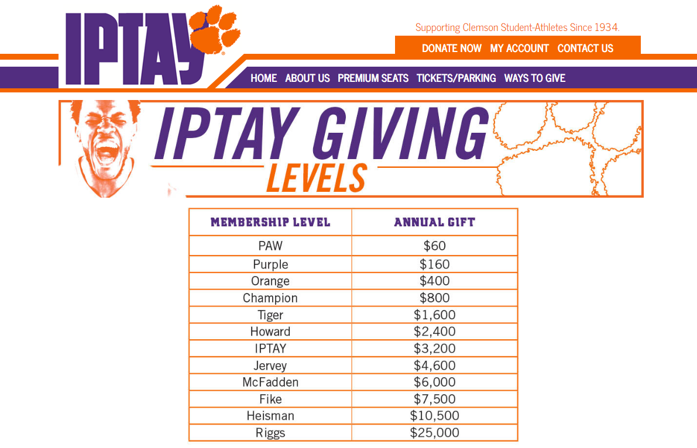
Collegiate Model at the High School Level

Slide 5
introducing
Starting at only $50

Slide 6
ONE TOWN, ONE TEAM.
PALMETTO POPULATION : 13,446
ELLENTON POPULATION: 4,300
PARRISH POPULATION: 19,589
MEMBERSHIP GOAL: 1,500
TOTAL POPULATION : 37,335
% OF AREA POPULATION GOAL: 4%
% OF PALMETTO POPULATION GOAL: 11%

Slide 7
ONE TOWN, ONE TEAM.
1,500 MEMBERS

Slide 8
PERSONAL MEMBERSHIP PACKAGES

Slide 9
CORPORATE MEMBERSHIP PACKAGES

Slide 10
SEASON TICKET PACKAGE PERKS
ALL MEMBERSHIP PERKS OF IPFAM
SEASON TICKET IN RESERVED SEATING / BOOSTER SECTION
SEAT-SIDE SERVICE AT FOOTBALL GAMES
HOSPITALITY TENT ACCESS
ANNUAL SEASON TICKET PACKAGE – ISSUED DIRECT
PARKING PASS
DISCOUNT CARD
ONLINE/GAME PROGRAM LISTING
OFFICIAL PALMETTO TIGER PRIDE™ LEVEL-SPECIFIC MERCHANDISE

Slide 11
5 Year Plan for Booster Membership
The goal of the plan is to AGGRESSIVELY MARKET season reserve tickets sales steadily over the next 5 years to achieve a maximum goal of 350 season ticket holders. In addition to the season ticket fee, patrons will be asked to voluntarily join the boosters on an annual basis as a philanthropic gesture to help assist the athletic program. In exchange for their contribution, members will receive the following benefits:
Booster Membership (Voting Rights)
Booster merchandise (hat, shirt, license plate, decal)
Football program recognition
Hospitality tent access and concierge service
Accumulation of Priority Points
Email Newsletter
Annual Booster sponsored dinner invitation to recognize members and their contributions

Slide 12
2018 PLAN FOR TICKET SALES
ITEM NAME | SCHOOL REVENUE | BOOSTER REVENUE
SALE OF EXISTING APPROX. 172 SEASON TICKET HOLDERS (@ $60) | $10,320
SECTION F (72 SEASON TICKETS @ $60) BUYOUT | $4,320
SECTION F (BOOSTER MEMBERSHIP FEE) ($100 PROFIT AFTER COST) |  | $7,200
CURRENT SEASON TICKET HOLDERS IPFAM UPGRADE ($50 X 147) |  | $7,350
CURRENT SEASON TICKET HOLDER VARSITY CLUB UPGRADE ($100 X 25) |  | $2,500
TOTALS | $14,640 | $17,050

Slide 13
5-YEAR PLAN FOR TICKET SALES
ITEM NAME | SCHOOL REVENUE | BOOSTER REVENUE
SALE OF APPROX. 350 SEASON TICKETS @ $60 | $21,000
AVERAGE BOOSTER MEMBERSHIP ($100 X 350) |  | $35,000
TOTALS | $21,000 | $35,000

Slide 15
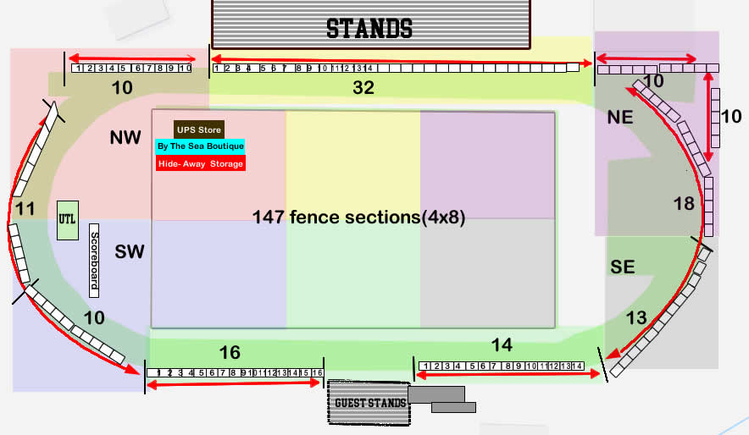
5 YEAR PLAN FOR ADVERTISING

Slide 16
Banner Sales
In order to achieve our revenue objectives, one of the mechanisms at our disposal is stadium banner sales. In the diagram, there are displayed, 147 fence sections (4x8) which are available for sale through PHS Boosters. The goal over 5 years is to sell all banner spots at an average of $300.00 annually.
$300.00 X 147 = $44,000.00 Annual Revenue

Slide 17
FOOTBALL HOME GAME REVENUE
2018 PROJECTED REVENUE
Ticket/Membership (stadium) Revenue =$31,690
*Concession Profit (excluding merchandise) =$5,000
TOTAL =$36,690
YEAR 5 PROJECTED REVENUE
Ticket/Membership (stadium) Revenue =$56,000.00
Concession Revenue =$15,000.00
TOTAL =$71,000.00
BANNER SALES (ADDDITIONAL ) = $44,000.00
TOTAL =$115,000.00

Slide 18
WHAT WE NEED…
FROM PALMETTO HIGH ADMINISTRATION

Slide 19
WHAT ARE WE ASKING….
APPROVAL TO BUY 72 SEASON TICKETS (SECTION F) OUTRIGHT FOR $4,320 (PAID IN FULL TODAY OR FIRST AVAILABLE DATE)
APPROVAL TO ERECT (AT OUR OWN LABOR & COST) A HOSPITALITY TENT FOR SELECT BOOSTER LEVEL MEMBERS EACH HOME GAME.
PERMISSION TO SELL BANNER ADS ON THE FOOTBALL STADIUM.
OPTIONAL: PERMISSION TO MANAGE NORTH SIDE CONCESSION STAND.

Slide 20
OPEN FORUM

