Slide 1
PHS ATHLETIC BOOSTERS
5 YEAR PLAN

Slide 2
The 5 YEAR PLAN
is a necessary component of the PHS Booster Club in order to place Palmetto High School athletics in a position of strength against upcoming competition in our area. The goal is to provide maximum financial assistance to the athletic department and in addition, ensure that no student athlete would want to transfer/enroll in any other school because our program is the best choice for them. To achieve this goal, the following steps must be taken:

Slide 3
Increase membership to a target of 1500 individual and corporate members
Maximize advertising sales for athletics
Assist the school in selling reserve season football tickets
Increase concessionary revenue
Assist all athletic programs in fundraising efforts
Provide funds for facility upgrades
Endow all scholarships
Increase revenue through special events

Slide 4
5 Year Plan for Ticket Sales
The goal of the plan is to aggressively market season reserve tickets sales steadily over the next 5 years to achieve a maximum goal of 350 season ticket holders. In addition to the season ticket fee, patrons will be asked to voluntarily join the boosters on an annual basis as a philanthropic gesture to help assist the athletic program. In exchange for their contribution, members will receive the following benefits:
Booster merchandise (hat, shirt, license plate, decal)
football program recognition
Hospitality tent access and concierge service
Annual Booster sponsored dinner invitation to recognize members and their contributions
2018 PROJECTED SCHOOL TICKET REVENUE
Annual (approximate) season ticket sales: 172 season ticket holders@ $60.00 = $10,320
2018 PROJECTED BOOSTER AND TICKET REVENUE
Section F- 72 season tickets@ $60.00 = $4,320
Section F- 72 Booster Membership Fee (72x200) = $14,400
Current season ticket holders (150) X $100.00 average booster membership = $15,000
Total = $33,720
PROJECTED 5 YEAR TICKET SALES AND REVENUE
350 season tickets @ $60.00 = $21,000
350 season ticket holders @ $100.00 average booster membership = $35,000
Annual Total = $56,000

Slide 5
FOOTBALL HOME GAME REVENUE
2018 PROJECTED REVENUE
Ticket/Membership (stadium) Revenue =$33,720
*Concession Revenue (excluding merchandise) =$20,000
TOTAL =$53,720
YEAR 5 PROJECTED REVENUE
Ticket/Membership (stadium) Revenue =$56,000.00
Concession Revenue =$35,000.00
TOTAL =$91,0000.00
BANNER SALES (ADDDITIONAL ) = $44,000.00
TOTAL =$135,000.00

Slide 6
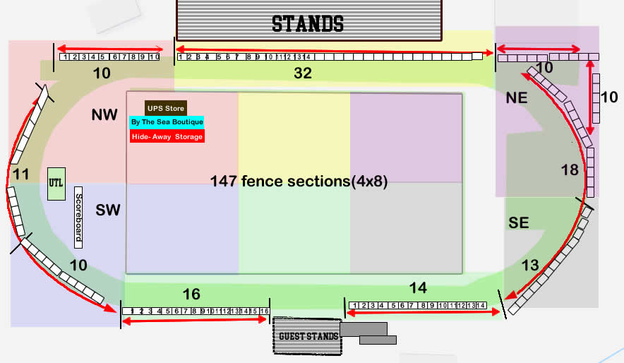
5 YEAR PLAN FOR ADVERTISING
ADVERTISING SALES

Slide 7
Banner Sales
In order to achieve our revenue objectives, one of the mechanisms at our disposal is stadium banner sales. In the diagram, there are displayed, 147 fence sections (4x8) which are available for sale through PHS Boosters. The goal over 5 years is to sell all banner spots at an average of $300.00 annually.
$300.00 X 147 = $44,000.00 Annual Revenue

Slide 8
ADDITIONAL PROJECTS
The projections listed previously were centered on football season revenue. To achieve our goal of providing the best athletic program for young people in our community to participate in, additional revenue sources will need to be created. They are:
Memberships and sponsorships (both individual and corporate)
Special Events (throughout the school year)
These additional revenue streams are needed to fund vital projects such as:
Capital Campaign (facility upgrade/improvements)
Scholarship Endowment Fund
*These programs will be addressed in more detail after football season

